Slide 1
CARDIOPREDICT-USING LOGISTIC REGRESSION
TEAM MEMBERS
KONDURI SHIVANI-2110030284
ADIMULAM BHAVYA SRI-2110030067
NOULURI RAJASHRI-2110030283
VIVEK RAJA-2110030022
Under the Guidance of
DR.SAIDI REDDY
Computer Science and Engineering Department
KL Hyderabad Off Campus, Aziz Nagar ,Hyderabad

Slide 2
Overview
Introduction
Objectives of the Project
Proposed Methodology/Architecture/Algorithm/Technique/etc
Implementation Details
Results (If any one objective is completed)
References

Slide 3
PROBLEM STATEMENT
The world health organization has estimated that 12 million deaths worldwide every year due to heart diseases.
The major challenge in heart disease is its detection.
There are instruments that can predict heart disease, but they are either too expensive or too inefficient to calculate the risk of heart disease in humans. Early detection of cardiac diseases has been shown to reduce mortality and overall complications.
However, it is not possible to accurately monitor patients every day in all cases, and 24 hour consultation by a doctor is not available because it requires more intelligence, time, and expertise.
We can use various machine learning algorithms to analyse data for hidden patterns in today's world because we have a lot of data.
Hidden patterns in medicinal data can be used for health diagnosis

Slide 4
Objectives of the Project
The primary objective is to predict the disease using a smaller number of variables.
The goal of this project is to determine whether a patient is likely to be diagnosed with any cardiovascular heart diseases based on medical characteristics such as gender, age, chest pain, fasting sugar level, and so on.

Slide 5
DATA SET REFERENCE
Gender (value 1: Male; value 0 : Female)
Chest Pain Type (value 1: typical type 1 angina, value 2: typical type angina, value 3: non-angina pain; value 4: asymptomatic)
Fasting Blood Sugar (value1: > 120 mg/dl;value0:< 120 mg/dl)
Exang – exercise induced angina (value 1: yes; value 0: no)
CA – number of major vessels colored by fluoroscopy (value 0 – 3)
Thal (value 3: normal; value 6: fixed defect; value 7:reversible defect)
Trest Blood Pressure (mm Hg on admission to the hospital)
Thalach – maximum heart rate achieved
Age in Year
Height in cms
Weight in Kgs.
Cholestrol

Slide 6
Implementation Details
In this Project We have used Logistic Regression as Machine learning algorithm.
Predicting heart disease using logistic regression has several practical applications in healthcare and related fields.
Early Diagnosis and Screening
Personalized Treatment plans
Health care Management
Research and Development
Public Health and Policy making

Slide 7
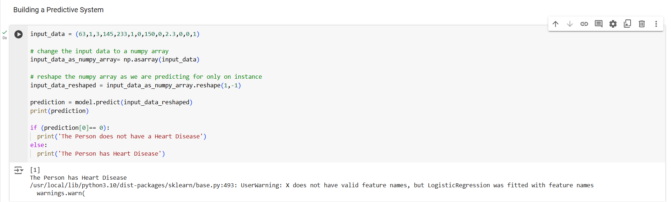
Results

Slide 8
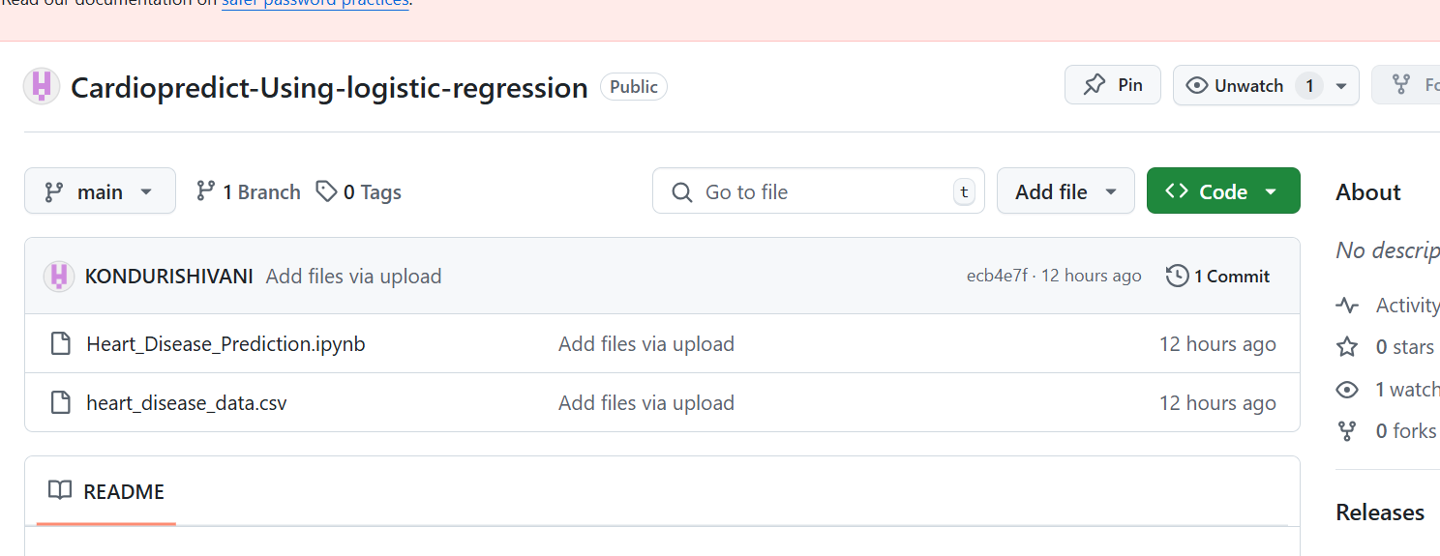
GITHUB LINK REPOSITORY

Slide 9
References
Logistic Regression Overview: https://towardsdatascience.com/logistic-regression-detailed-overview-46c4da4303bc
Scikit-learn Documentation for Logistic Regression: https://scikit-learn.org/stable/modules/generated/sklearn.linear_model.LogisticRegression.html]
Understanding Cardiovascular Diseases and Early Diagnosis:
https://www.who.int/news-room/fact-sheets/detail/cardiovascular-diseases-(cvds)]

Slide 10
Thank you

